Slide 1
Genuine Joe’s Coffee
Presentation

Slide 2
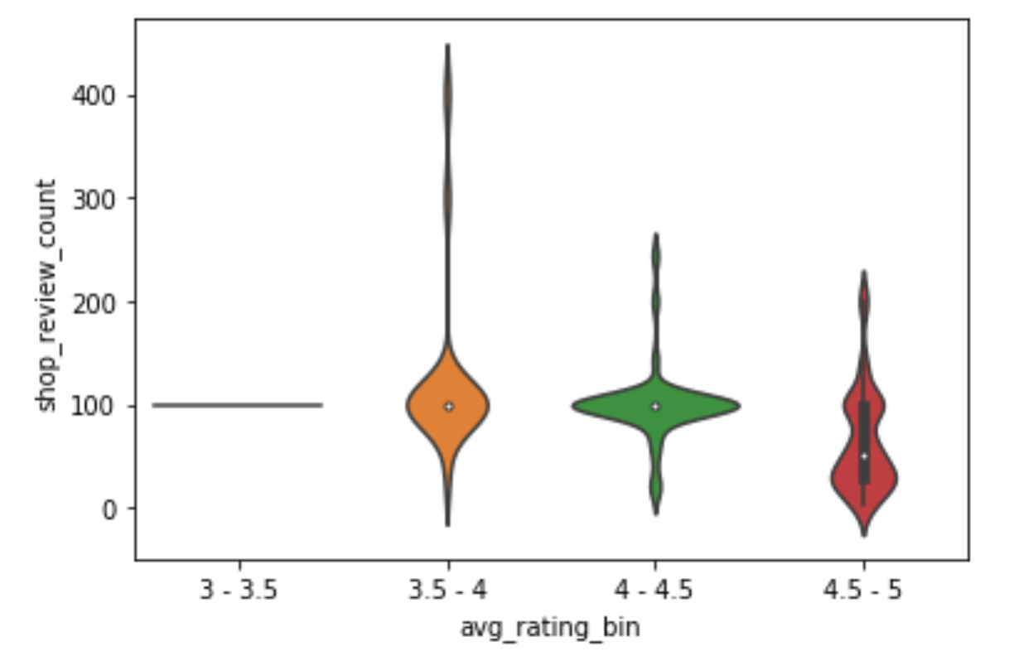
Genuine Joe Market Comparison
Genuine Joe’s is in an undifferentiated market sector: coffee shop with an average Yelp rating between 3.5 - 4 stars (3.95), with a review count of 100
This is represented by the middle orange area
Ideally, we want to get to the skinny red sector
represents top performers in the market: coffee shops with an average Yelp rating between 4.5 - 5 stars, with a review count over 100

Slide 3
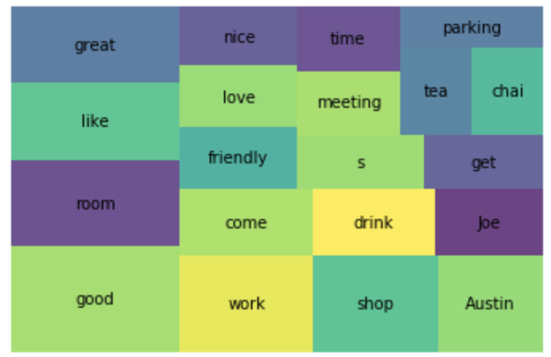
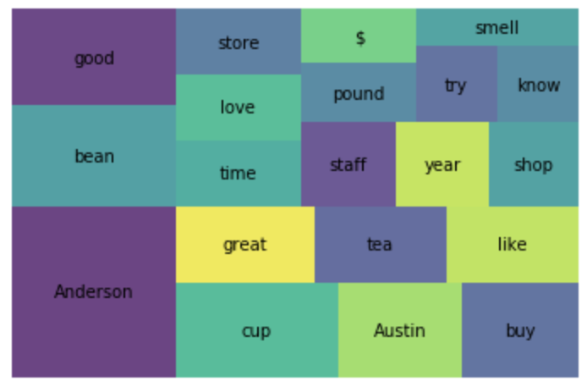
Positives - Us vs. the Market
We are going a great job in terms of the funky atmosphere we provide our customers, noted by the number of times ‘room’ comes up in positive reviews.
‘Room’ appears in 33% of positive reviews, while only 8% of negative reviews.
Anderson Coffee Company is who we strive to be. They have an average Yelp rating of 4.62 stars, with 100 reviews.
They are known for authentic Texas feel, with keyword ‘Austin’ appearing in most good reviews.

Slide 4
Genuine Joe’s - Areas for Improvement
Coffee taste - ‘taste’ keyword came up in 20% of bad reviews compared to 2.6% of good reviews
Night service - ‘night’ keyword came up in 16% of bad reviews compared to 1.3% of good reviews

Slide 5
Ideas For Improvement
Find better bean blends for coffee
Maintain funky atmosphere, but try to spice it up with some Texas/Austin-specific decorations
Consider adding ice cream to the menu; well-executed ice cream/coffee shop combo stores had high ratings with high review counts

